Slide 1
INTRODUCTION TO COUNSELLING

Slide 2
What is Counseling?
This is a therapeutic process of helping the client to see issues more clearly, from a different view-point.
It enables the client to focus on feelings, thoughts or behaviour, with a goal to facilitate a positive change.

Slide 3
Difference between Counseling and Guidance?
Counseling
Guidance
Counseling is a more inward analysis,
Counseling is in-depth, narrowing down the problem until the client understands his/her own problem,
Counseling is mostly on personal and social issues,
Focus on counseling is not on the solution but on understanding the problem as it allows the counselor to bring about emotional change or change in feeling
Most problems can be solved with the right amount of dedication, contemplation and understanding.
Guidance is much more external
Involves giving advice
Guidance is broader and comprehensive.
Guidance is generally education and career related
In guidance the focus is on finding a solution, which may bring a change in attitude of the client.
Takes a shorter time

Slide 4
Types of Counseling
Individual Counseling
Individual counseling is a personal opportunity to receive support and experience growth during challenging times in life.
Couples Counseling
Marriage counseling or couples counseling can help resolve conflicts and heal wounds. Overall, couples counseling can help couples slow down their spiral and reestablish realistic expectations and goals.
Family Counseling
Family counseling is often sought due to a life change or stress negatively affecting one or all areas of family closeness, family structure (rules and roles) or communication style.
Group Counseling
To be involved in a group of peers who are in a similar place not only increases one’s understanding of the struggles around the topic but also the variety in the possible solutions available. A common topic like: anger management, self-esteem, divorce, domestic violence, recovery from abuse and trauma, and substance abuse and recover

Slide 5
COUNSELLING THEORIES

Slide 6
COUNSELLING THEORIES
What is a Theory- A Theory is a picture, an image, a description, a representation of reality. It is a way we can think about some part of reality so that we can comprehend it”
It’s a set of assumptions that attempt to describe a reality

Slide 7
Psychodynamic Theory – Sigmund Freud
This was the First Counselling Theory (First Force)
Goal: Making the unconscious, conscious
Our behavior and feelings are powerfully affected by unconscious motives.
Our behavior and feelings as adults (including psychological problems) are rooted in our childhood experiences.
All behavior has a cause (usually unconscious), even slips of the tongue. Therefore all behavior is determined.

Slide 8
Behavior is motivated by two instinctual drives:
Eros (the sex drive & life instinct) and Thanatos (the aggressive drive & death instinct).
Both these drives come from the “id”.

Slide 9
Personality is made up of three parts (i.e. tripartite): the id, ego and super-ego.
Parts of the unconscious mind (the id and superego) are in constant conflict with the conscious part of the mind (the ego). This conflict creates anxiety, which could be dealt with by the ego’s use of defence mechanisms.

Slide 10
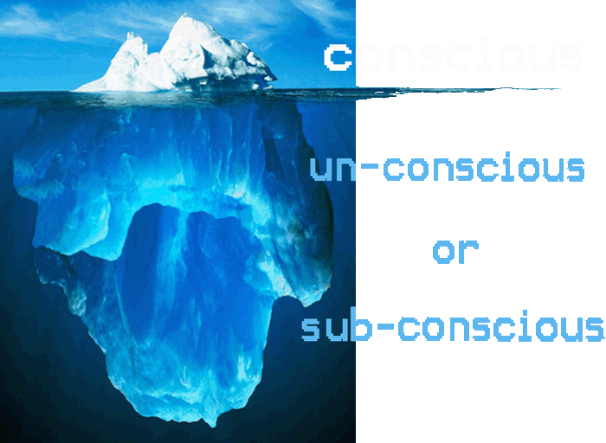

Slide 11
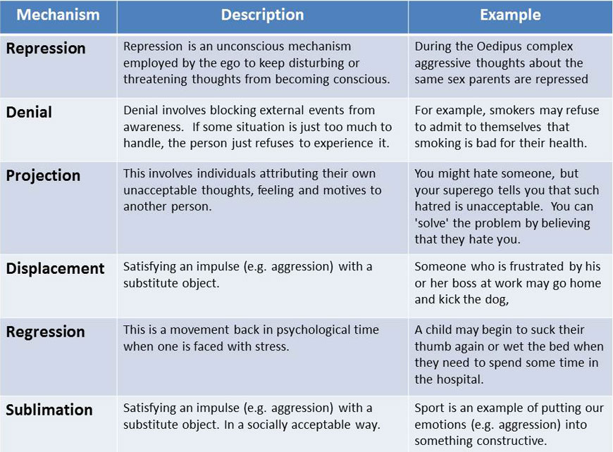
Psychosocial Development stages
Oral phase (0-1 yr.) – chewing, nail biting, thumb sucking, talkers
Anal Phase (1-3yrs) – anal retentive, anal repulsive (overly tidy, generous, authority)
Phallic phase (3-6 yrs.) –genitalia, masturbation- Oedipus complex, Electra complex)
Latency phase (6 yrs. –puberty) - sublime games work etc.
Genital phase (puberty- adulthood) - settling down in a relationship

Slide 12
Person Centered Theory- Carl Rodgers

Slide 13
Goal: People are essentially good, and that ultimately the individual knows what is right for them, this is the essential ingredient of a successful person centered therapy as “all about loving”.

Slide 14
Core Conditions
Congruent
Unconditional Positive Regard (UPR).
Empathetic

Slide 15
Congruence in Counseling
Congruence is also called genuineness. Congruence is the most important attribute in counseling, according to Rogers. The counsellor is keen to allow the client to experience them as they really are.

Slide 16
Unconditional Positive Regard
This refers to the therapist's deep and genuine caring for the client. The therapist may not approve of some of the client's actions, but the therapist does approve of the client. In short, the therapist needs an attitude of "I'll accept you as you are." The person-centered counselor is thus careful to always maintain a positive attitude to the client, even when disgusted by the client's actions.

Slide 17
Empathy
Empathy is the ability to understand what the client is feeling. This refers to the therapist's ability to understand sensitively and accurately [but not sympathetically] the client's experience and feelings in the here-and-now.

Slide 18
BEHAVIOURAL THERAPY

Slide 19
Behavioral Therapy-
Ivan Pavlov; BF Skinner, Albert Bandura
Goal: A behavior is learnt, it can also be unlearned and re-learnt.
Behaviorism assumes that all behavior is learnt from the environment and symptoms are acquired through.
Behaviour therapy offers various action oriented methods to help people take steps to change what they are doing and thinking.

Slide 20
What are the basic assumptions?
The person is the producer and the product of his or her environment.
We are not only influenced by our surrounding, we have the capacity to actually affect our environment.
Behaviour is the product of learning and can be learnt and relearn good behaviour.

Slide 21
Major Behavioural Therapies

Slide 22
Classical conditioning (Ivan Pavlov)-
It involves learning by association and is usually the cause of most phobias
It involves the pairing of a neutral stimulus and a natural stimulus (conditioned stimulus)
He did an experiment and confirmed that when food was placed in the dog’s mouth the dog would salivate
He later rang the bell and provided food to the dogs
Hungry when you smell food, anxious with a dentist drill, excited when mobile notification goes off

Slide 23
Operant conditioning. (BF Skinner)-
It involves learning by reinforcement (e.g., rewards and punishment) and can explain abnormal behavior should as eating disorders.
He came up with the following:
Positive rein forcers
Are rewards given each time somebody gives a correct response to a stimulus. E.g. money, comfort, affection, praise and food.
Negative Rein Forcers
It involves the removal of an unpleasant stimulus once the correct response has been made. – court fines, losing phone privileges

Slide 24
SOCIAL LEARNING – ALBERT BANDURA (1925)
Social Learning theory emphasize that behavior is learned through experiences with the environment and that cognitive factors influence learning.
For Observational learning to take place Bandura came up with the following requirements:
Attention - Without which no one can learn
Retention- Which is essential if observable behavior is to be remembered.
Reproduce- Reproduce the behavior retained when appropriate
Motivation -A good reason to perform the act.
(child learns to say thank you, media and role model influences, study habits from top performers)

Slide 25
Goals of therapy
To help clients acquire skills or alleviate their problem.
Relieving people of behaviors that interfere with effective living.
Help the client replace maladaptive behaviors with adaptive one.

Slide 26
Therapist function and role
Become a role model
Explaining alternative courses of action that are available.
Helping clients deal with their anxieties.

Slide 27
Therapy Techniques
Relaxation – breathing, dancing, laughing, take a leave
Systematic Desensitization
Aversive Therapy
Flooding
Assertive Training
Aversive Training
Modelling – Live, Symbolic, Multiple

Slide 28
Rational Emotive Behavior Therapy (REBT)- Albert Ellis
Goal: People are largely irrational, guiding them to act and react in ways that are inappropriate, change the irrational thoughts

Slide 29
It proposes that each of us hold a unique set of assumptions about ourselves and our world that serve to guide us through life and determine our reactions to the various situations we encounter.

Slide 30
Common Irrational Assumptions:
• The idea that one should be thoroughly competent at everything.
• The idea that is it catastrophic when things are not the way you want them to be.
• The idea that people have no control over their happiness.
• The idea that you need someone stronger than yourself to be dependent on.
• The idea that your past history greatly influences your present life.
• The idea that there is a perfect solution to human problem, and it’s a disaster if you don’t find it.

Slide 31
Cognitive Therapy- ABC Technique of Irrational Beliefs.
A - Activating Event or objective situation. This is an event that ultimately leads to some type of high emotional response or negative dysfunctional thinking.
B - Beliefs. –This is the belief/ assumption that a client hold about the event
C - Consequence. This is the negative feelings and dysfunctional behaviors that ensued. The negative thoughts are seen as a connecting bridge between the situation and the distressing feelings.

Slide 32
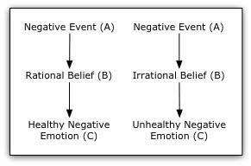

Slide 33
Example
Gina is upset because she got a low mark on a math test. The Activating event, A, is that she failed her test. The Belief, B, is that she must have good grades or she is worthless. The Consequence, C, is that Gina feels depressed.

Slide 34
Cognitive Behavioural Therapy –
Aoron Beck
CBT was developed in the 1950s by Aaron Beck, a psychoanalyst who noticed that changing thought patterns could significantly reduce symptoms of depression and anxiety.

Slide 35
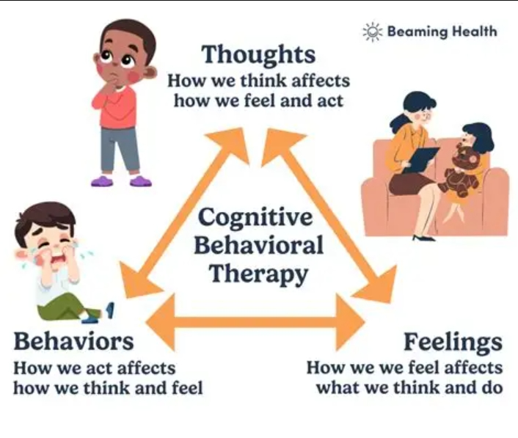

Slide 36
Key Principles
Thoughts, feelings and behaviours are interconnected: Negative or distorted thinking can lead to emotional distress and maladaptive behaviour
Psychological problems are partly learned: Unhelpful behaviours and thought patterns are learned and can be unlearned through therapy.
Skills can be learned to cope effectively:
Individuals can develop strategies to manage symptoms and improve quality of life

Slide 37
Common Uses
CBT is effective for treating:
Depression
Anxiety disorders
Post-traumatic stress disorder (PTSD)
Eating disorders
Phobias
Stress management

Slide 38
Techniques
Cognitive restructuring: Spotting and reframing negative thoughts.
Exposure therapy: Gradual exposure to feared situations to reduce avoidance.
Behavioral activation: Encouraging engagement in positive activities.
Problem-solving skills: Building strategies to handle challenges effectively.

Slide 39

Thank You

